Slide 1
FACULTY OF COMPUTING AND INFORMATION SYSTEMS
FINAL PROJECT GUIDE

Slide 2


Slide 3
Abstract
This is a brief summary of the project work and most likely to be widely published and read.
It should have concise description of the Problem(s) addressed, the Methods for the solution, the Results and Conclusions.
The whole abstract should be composed as one paragraph.
A maximum limit is set for half a page or 250 words.

Slide 4
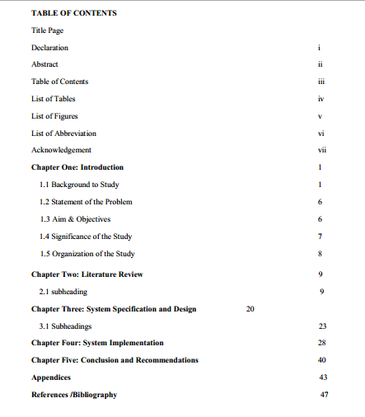

Slide 5
List of Tables, List of Figures and List of Abbreviations
These should be on separate pages and included only as appropriate. LIST OF FIGURES
Figure Page
1.1 Login Form…………………………………………………………2
1.2 System Setup……………………………………………………….8
2.1 Payroll Report………………………………………………………9

Slide 6
CHAPTER ONE
1.1 Introduction
1.2 Background to Study
1.3 Statement of the Problem
1.4 Aim & Objectives
1.5 Significance of the Study
1.6 Scope And Limitation Of The Research Work
1.7 Organization of the Study

Slide 7
1.1 Introduction
Provide a short overview or introduction of the research in this section.
Introduction is that part of a document that tries to introduce the document in an interesting manner to the reader.

Slide 8
1.2 Background to Study
The purpose of a background/history section is to give the reader the relevant facts about the topic
and/or research site so that they understand the material or case in the research.

Slide 9
1.2 Statement of the Problem
Logically, the first step in any research is to provide a clear statement of the problem.
A research problem is a definite or clear expression about an area of concern, a system to be improved, a difficulty to be eliminated that exists in scholarly literature, or within practice that points to meaningful investigation or solutions.

Slide 10
1.3 Aim & Objectives
These need to be deduced from the problem statement.
Objectives of the research define how the aims are going to be realised.
In Informatics, Computer Science and related disciplines they define what experimental results, programs and that might be used to satisfy the aims.

Slide 11
1.4 Significance of the Study
It is also necessary to specify why your research is important and what new insights may be found.
What would be its net contribution to the body of knowledge in the field, and/or towards solving the problems humanity at large?

Slide 12
1.5 Scope And Limitation Of The Research Work
State the areas your research will cover and/or not cover.
In other words, scoping a project means drawing boundaries around it,
So that everyone knows what will be done and what will not be done.

Slide 13
1.6 Organization of the Study
Research thesis also contain tentative chapter outline.
It indicates the number of chapters the thesis or dissertation is expected to be composed of.
It gives the tentative chapter headings with brief annotations of expected chapter content.

Slide 14
CHAPTER TWO LITERATURE REVIEW

Slide 15
LITERATURE REVIEW
Literature review is a well-organized critical appreciation of relevant literature related to the your research.
The student should show whether other researchers have studied the same or similar problems before, from what perspectives have these studies been conducted, and whether these researches have been adequate.

Slide 16
LITERATURE REVIEW
Essentially, this part of your thesis document will form the bulk of your citations [Refer to part two for the Harvard referencing system guide].
The literature review should reference only publicly available material.
The purpose of this section is to illuminate the area of research not to reference “magic documents” that are impossible to find.

Slide 17
Chapter Three: System Specification and Design
3.1 Software development methodology
3.2 Functional Requirement
3.3 Non Functional Requirements
3.4 Use Cases
3.5 System Architectural Design

Slide 18
3.1 Software development methodology
A software / system development methodology is a framework that is used to structure, plan, and control the process of developing an information system.
Common methodologies include waterfall, prototyping, incremental development, spiral development, rapid application development, and extreme programming.
This section should explain your choice of software development methodology highlighting reasons for the choice and how the methodology was used to achieve the set research objectives.

Slide 19
3.2 Functional Requirements
Functional requirements define a function of a system or its component. A function is described as a set of inputs, the behaviour, and outputs.
In developing the web application for the auto car shop, the functional requirements include:
The web application shall accept and process customer orders
The web application shall produce a receipt detailing a customers’ purchase information and include name of customer, items purchased, cost of each item and total cost
The web application shall be able to produce weekly, monthly and yearly reports about sales

Slide 20
3.3 Non Functional Requirements
A non-functional requirement is a requirement that specifies criteria that can be used to judge the operation of a system, rather than specific behaviours.
Some non-functional requirements for the auto shop application could include:
The web application shall be easy to use by all employees including sales representatives and managers
The web application shall be available in several languages
The web application shall allow several sales to be made at the same time without downgrading performance

Slide 21
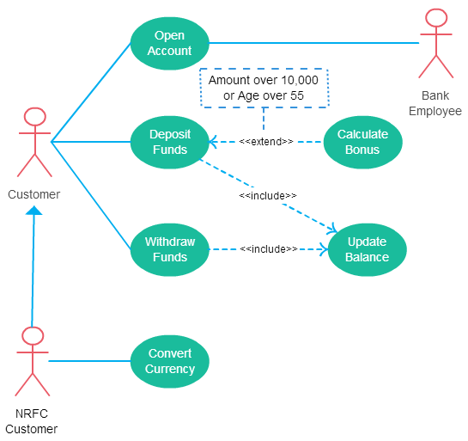
3.4 Use Cases
Each use case illustrates behavioural scenarios through one or more functional requirements.

Slide 22
Non Functional vs Functional Requirements
An example of a functional requirement would be:
A system must send an email whenever a certain condition is met (e.g. an order is placed, a customer signs up, etc).
A related non-functional requirement for the system may be:
Emails should be sent with a latency of no greater than 12 hours from such an activity.

Slide 23
Non Functional vs Functional Requirement
Functional requirement: for example if the application is a banking application that application should be able to create a new account, update the account, delete an account, etc.
Non-functional requirement :for example for an banking application a major non-functional requirement will be availability the application should be available 24/7 with no down time if possible.

Slide 24
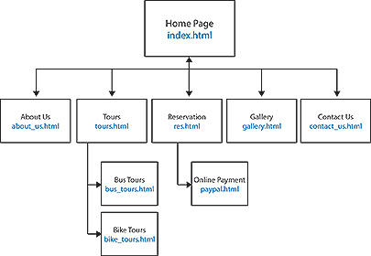
3.5 System Architectural Design

Slide 25
Chapter Four: System Implementation
4.1 Development tools and platform
4.2 Database Design
4.3 User Interface Design

Slide 26
4.1 Development tools and platform
This section should indicate all tools, programming languages, IDEs, frameworks and platforms to be used in the development process. Justify your choice for the tool or platform.

Slide 27
4.2 Database Design
Design the system data structures and how these are to be represented in a database.
Explain how data integrity is ensured by your design [ensure that the database is fully normalised].
Depict the design using entity relationship diagrams.

Slide 28
4.3 User Interface Design
Describe the characteristics of each interface between the product and its users (e.g., screen formats/organization, report layouts, menu structures, error and other messages, or function keys).

Slide 29
Chapter Five: Conclusion and Recommendations
5.1 Summary
5.2 Challenges
5.3 Recommendations

Slide 30
5.1 Summary
Refer back to problem posed, and describe the conclusions that you reached from carrying out this project, summarize new observations, new interpretations, and new insights that have resulted from the present work.
• Include the broader implications of your results.

Slide 31
5.2 Challenges
Express challenges faced in the carrying out of the research.
Should not be more than 10 sentences.

Slide 32
5.3 Recommendations
Finally, it is very important that you present a roadmap for continuing the research you have reported.
You should present all questions/objectives that you did not address in you work and discuss why they are significant.

Slide 33
HARVARD REFERENCING SYSTEM
The most accepted way of acknowledging the work of another author is to use a referencing system.
At the Department of IT, you are required to use the Harvard referencing system. While there are many variations to the Harvard system, the one used in the guide is the simplest.
The following guide shows you how to insert references in the text of your thesis, and shows you how to compile a reference list.
There are two components to referencing: in-text citations in the main text and the reference list at the end of your thesis.

Slide 34
INTEXT CITING (Referencing in the text)
Harvard is an 'author/date' system, so your in-text citation consists of author(s) and year of publication.
EXAMPLES
The objectives of the scheme were to increase the proportion of the population receiving health care from 25 to 66 percent, establish a health care system best adapted to the local conditions and to the level of health technology in this information age (Sorungbe, 1989).

Slide 35
In-text examples
Amponsah (2001) opined that
Osei (2000) perceived ICT as …………………
Computer compliance by people according to Thompson (2000) has become the accelerator for productivity and prosperity.
According to Broadbent (1987), lack of successful………….
Turkson (2006) acknowledged that………..

Slide 36
Examples of words for introducing in-text citations
According to…
In the words of…
In a recent study by…
Current research proves that…
You can write that someone…
acknowledges, adds, admits, or agrees
argues, asserts, claims, or comments
confirms, believes, declares, or implies
insists, notes, observes, or points out,
reports, states, theorizes, or writes

Slide 37
THE REFERENCE LIST
All in-text citations should be listed in the reference list at the end of your thesis.
Reference list entries contain all the information that someone needs to follow up your source.
Reference lists in Harvard are arranged alphabetically by author.

Slide 38
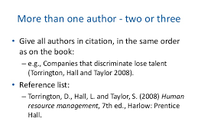

Slide 39
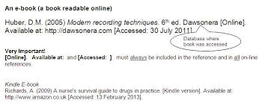

Slide 40
Website
Author of website SURNAME, Initials or WEBSITE name if no author is available. (Year - in brackets) Title of the first webpage where you find the information in italics. [Online in square brackets] Available from: URL. [Accessed: followed by date in square brackets].
EXAMPLE
BBC NEWS. (2008) Factory gloom worst since 1980. [Online] Available from: http://news.bbc.co.uk/1/hi/business/7681569.stm. [Accessed: 19th June 2012].

Slide 41
